Slide 1

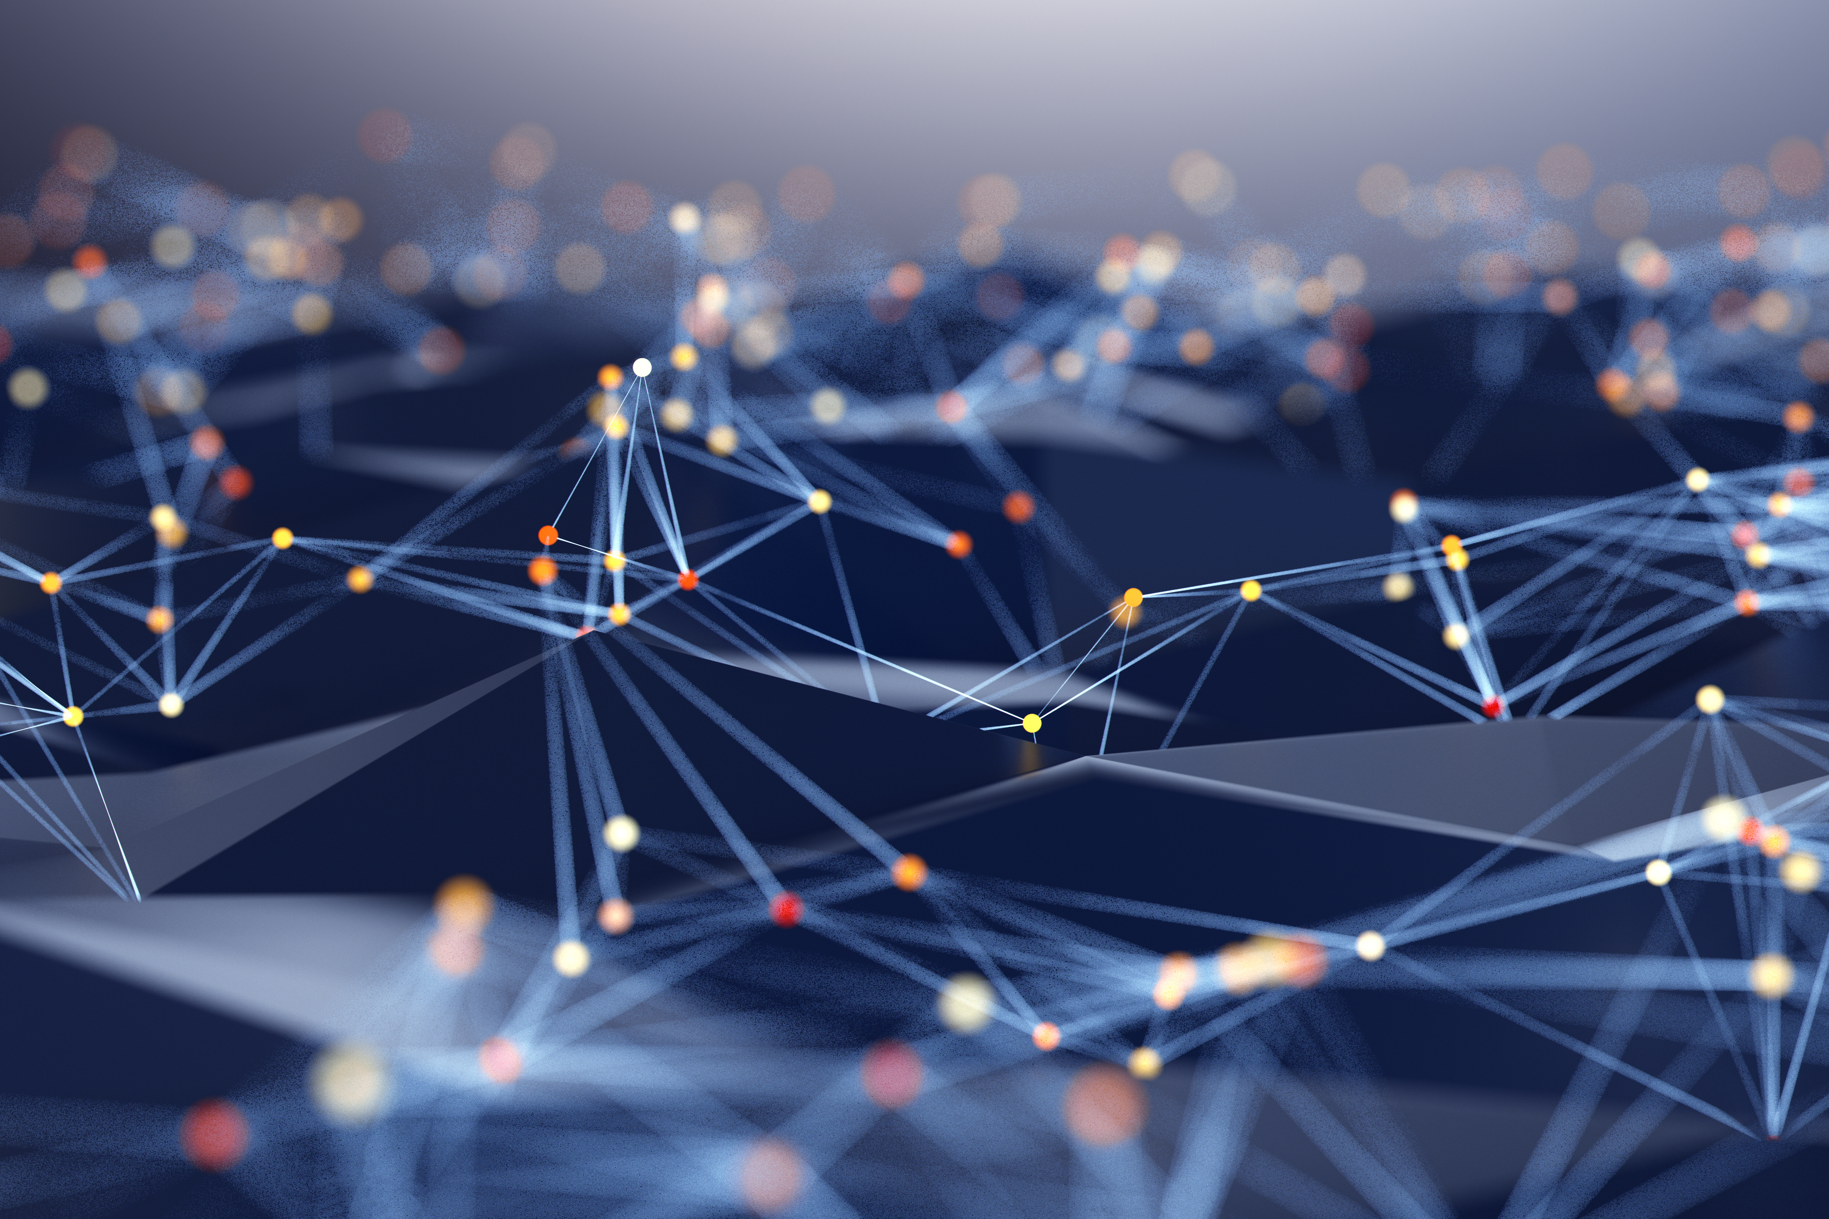
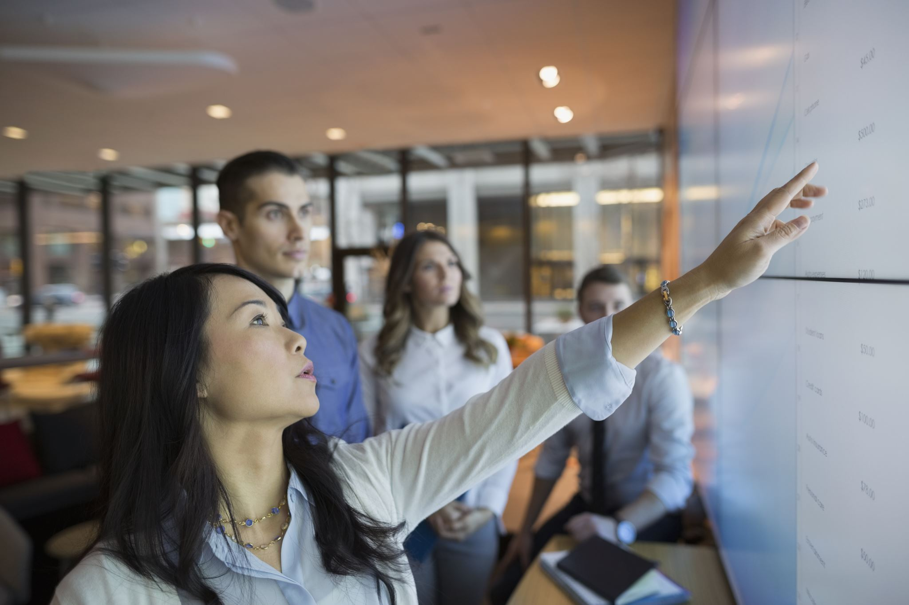
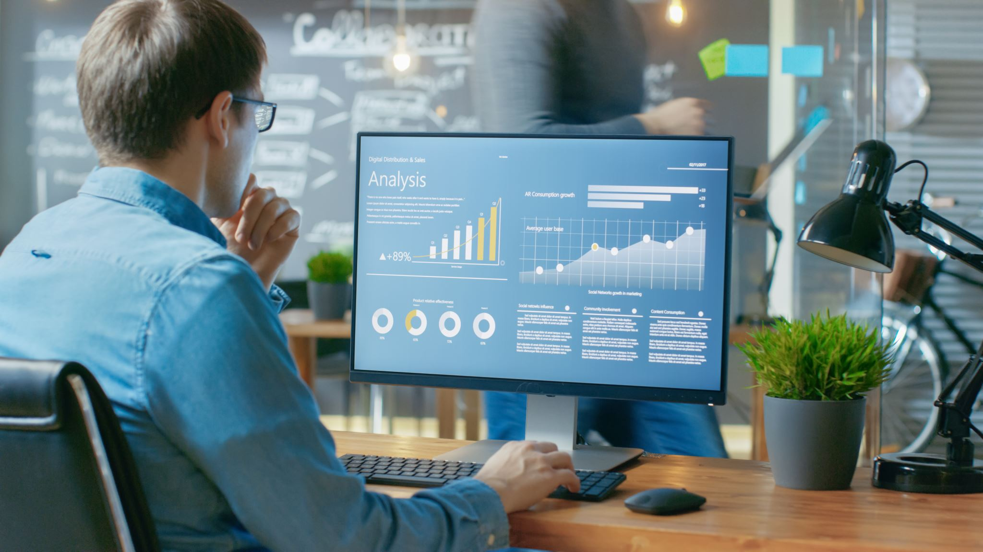
The Evolution of Facebook 2011-2021
The Society

Slide 2


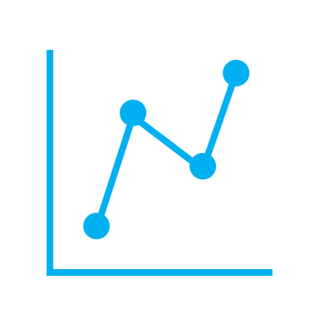

The Goal of Our Data
The keys to running a successful business is maintaining critical systems
Engagement
Trends
Time
[4]

Slide 3


Hypothesis:
The time you post affects your likes.
Question:
Higher engagement between 1 pm - 3 pm and 10 pm - 1 am
After reviewing the graph of reactions against time of the day, we concludedthe time that you post directly affects the number of reactions that you might ge
Does the time you post affect how many likes your post will get?

Slide 4
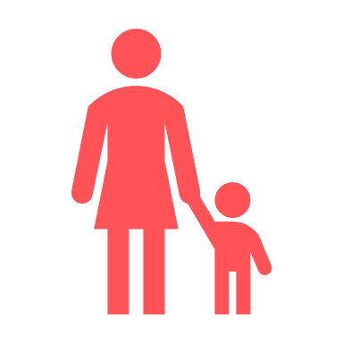
Hypothesis:
The older generation uses more reactions.
Question:
The engagement of younger generations is higher according to the amount of reactions.
The hours of activity are very similar and behave almost identically.
Which Generation reacted the most per hour?

Slide 5
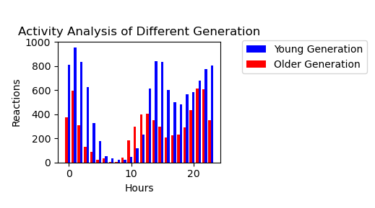
Continued:
The older generation uses more reactions.
Question:
Which Generation reacted the most per hour?

Slide 6


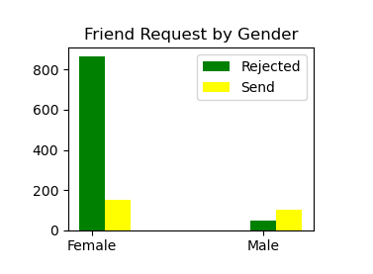
Hypothesis:
Males send more friend request.
Females reject more friend request
Question:
Takeaway#1
Takeaway#2
Takeaway#3
Which gender sends and rejects the most friend request?

